Slide 1
Distributed Stream Processing Frameworks (DSPF)
Apache Storm(Core) / Trident
Apache Spark Streaming
Apache Samza
Apache Flink

Slide 2
Apache Storm & Architecture
It is a distributed real-time big data-processing system, designed to process vast amount of data in a fault-tolerant and horizontal scalable method.
Storm makes it easy to reliably process unbounded streams of data, doing real-time processing what hadoop did for batch processing.
Supervisor
Worker
Nimbus
Zookeeper
Supervisor
Worker
Zookeeper
Supervisor
Worker
Cluster Coordination
Master Node
Launches worker
Process the work

Slide 3
Storm Topology
For real-time computation on Storm, we need to create "topologies". A topology is a graph of spouts and bolts that are connected with stream groupings.
The logic for a real-time application is packaged into a Storm topology.
It is analogous to a MapReduce job. One key difference is that a MapReduce job eventually finishes, whereas a topology runs forever (or until we kill it).
Bolt
Spout
Bolt
Bolt
Spout
Bolt
Storm Topology

Slide 4
Nimbus Service on Master Node - It is a daemon that runs on the master node of Storm cluster and is responsible for distributing the code among the worker nodes, assigning input data sets to machines for processing and monitoring for failures. Nimbus service relies on Apache Zookeeper service to monitor the message processing tasks.
Supervisor Service on Worker Node - All the workers nodes in Storm cluster run a daemon called Supervisor. It receives the work assigned to a machine by Nimbus service. Supervisor manages worker processes to complete the tasks assigned by Nimbus. Each of these worker processes executes a subset of topology.
Topology - It is a graph of computation contains processing logic, and links between nodes indicate how data should be passed around between nodes. It typically runs distributively on multiple worker nodes.
Spout - A Topology starts with a spout, source of streams. A stream is made of unbounded sequence of tuples. A spout may read tuples off a messaging framework and emit them as stream of messages or it may connect to an API and emit a stream of tweets.
Bolt - A Bolt represents a node in a topology. It defines smallest processing logic within a topology. Output of a bolt can be fed into another bolt as input in a topology.

Slide 5
Apache Storm-Trident
Trident is an extension of Storm. The main reason behind developing Trident is to provide a high-level abstraction on top of Storm.
Advantages
Trident is smart enough to run the topology for maximizing the performance.
At first it process computations within a partition then send the tuples over the network, improving the throughput and reducing network traffic.
For high throughput trident process the tuples in batches and does operations on batches.
It provides functions, filters, joins, aggregation and other operations on top of Storm, which in turn reduce the amount of programming you need to do in Storm.
One of the cool things about Trident is that it has fully fault-tolerant, exactly-once processing semantics.
Sample Use case:
Transform and process social media / IoT sensor streams in real-time.

Slide 6
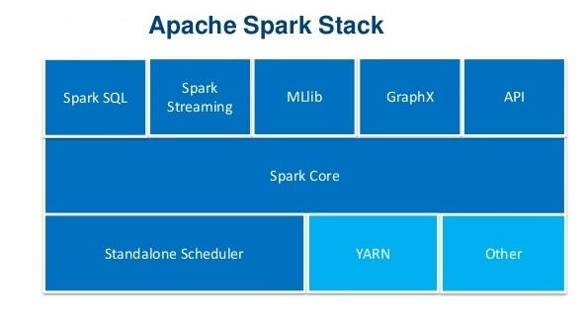
Apache Spark
Apache Spark has an advanced DAG execution engine that supports acyclic data flow and in-memory computing.
Spark Streaming is an extension of the core SparkAPI that enables scalable, high-throughput, fault-tolerant stream processing of live data streams.
Spark Streaming supports real time processing of streaming data, such as production web server log files, social media like Twitter, and various messaging queues like Kafka.
This is based on micro batch style of computing and processing. It uses the DStream which is basically a series of RDDs, to process the real-time data.

Slide 7
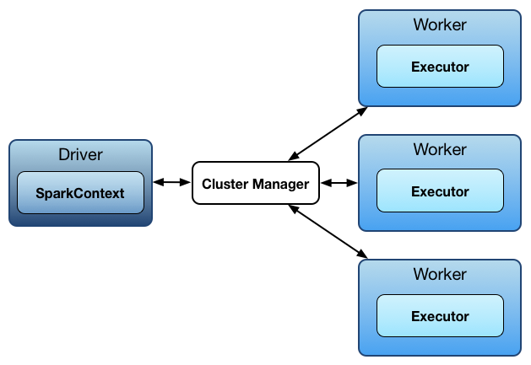
Execution flow
Spark uses a master/worker architecture. There is a driver that talks to a single coordinator called master that manages workers in which executors run.
Instead of processing the streaming data one record at a time, Spark Streaming discretizes the streaming data into tiny, sub-second micro-batches.
Sample Use case:
Processing social media feeds in real-time for performing sentiment analysis.

Slide 8
Apache Samza & Architecture
Apache Samza is a distributed stream processing framework. It uses Apace Kafka for messaging, and Apache Hadoop to provide fault tolerance, processor isolation, security, and resource management.
Samza is made up of three layers:
  Samza API
  YARN (Pluggable)
  Kafka (Pluggable)
Moreover it is the logical continuation of Kafka i.e. where kafka is the message broker, Samza is the technology that processes the data in the topics as it was distributed with Kafka.
Samza API
Samza API
Node Manager
Node Manager
YARN
Kafka Broker
Samza Container 1
Samza Container 2
Samza YARN AM
Kafka Broker

Slide 9
Samza approach to streaming is to process messages as they are received, one at a time.
Samza stream primitive is not a tuple or a Dstream, but a message.
Streams are divided into partitions and each partition is an ordered sequence of read-only messages with each message having a unique ID (offset).
Streams & Partitions
Streams are immutable messages.
Each stream comprises one or more partitions.
Partitions are totally ordered sequence of messages.

Slide 10
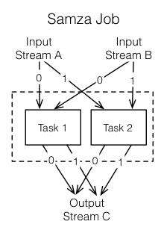
Samza Job Execution
After getting the input streams, Samza executes a job.
Jobs are further broken down into smaller execution units called tasks, which is the unit of parallelism, just as the partition is to the stream.
Each task consumes data delivered by one of the partitions.
A task processes messages sequentially, in the order of message offset.
Sample Use case:
Optimized stream processing for applications utilizing Kafka for ingestion.

Slide 11
Apache Flink
Apache Flink is an open-source framework for distributed stream processing . It is the true stream processing framework (doesn’t cut stream into micro-batches).
Flink processes events at a consistently high speed with low latency.
At the most basic level, a Flink program is made up of
  Data source: Incoming data that Flink processes.
  Transformations: The processing step, when Flink modifies incoming data
  Data sink: Where Flink sends data after processing.
Why Flink?
Performs at large scale, running on thousands of nodes with very good throughput and latency.
It provide the results that are accurate, even in the case of out-of-order or late-arriving data.
It can seamlessly recover from failures while maintaining exactly-once application state.
Data Source
Transformations
Data Sink

Slide 12






Apache Flink Stack / Apache Flink Ecosystem
The Flink Stack is based on a single runtime which is split into two parts batch processing and streaming.
Stream-Processing is the core of Flink. Batch-Processing is only a sub-type of Stream-Processing
Supports different cluster management systems and storages
Provides a highly modularized API comprising of libraries for Machine Learning, Graph Processing, Tabular Data Processing etc.
DataSet API
(Batch Processing)
DataStream API
(Stream Processing)
Flink Runtime
(Distributed Stream Data Flow)
Core
Local
Single JVM
Cluster
Standalone, YARN
Cloud
GCE, EC2
Deploy

Slide 13
Advantages of Flink over other DSPF
Unlike Spark, Flink does not require manual optimization and adjustment when the characteristics of the data it processes change.
It handles data partitioning and caching automatically as well, Flink analyzes its work and optimizes tasks in a number of ways.
Sample Use case:
Detection and prevention of fraudulent credit card transactions in real-time.

Slide 14
Comparison
 | Apache Storm Version – 0.10.0 | Storm Trident Version – 0.10.0 | Apache Samza Version – 0.10.0 | Spark Streaming Version – 1.6.1 | Apache Flink Version – 1.0
Processing /Streaming Model | One record at a time | Micro batching | One record at a time | Micro batching | One record at a time
Latency | Milliseconds (Very Low) | Seconds | Milliseconds | Seconds | Milliseconds
Throughput | Low | Medium | High | High | High
Fault Tolerance | Record ACK’s | Record ACK’s | Log Based | RDD Based Check Pointing | Check Pointing
Guarantees Processing | At-least once | Exactly once | At-least once | Exactly once, At-least once(with non-fault-tolerant sources) | Exactly once
Languages | Scala, Python, Java, Ruby, Clojure | Scala, Python, Java | Java | Scala, Python, Java | Scala, Java

Slide 15
Framework Recommendations
Storm
Storm is still a great fit for small and fast tasks. If you care mainly about the latency, storm might be a good way to go.
But also keep in mind the trident’s state management hurts the performance.
Interesting option might be a potential update to Twitter’s Heron, which is designed as Storm’s replacement and should be better in every single task, but the problem is there is no guarantee Twitter is going to open-source it.
Spark Streaming
If spark is already part of your infrastructure its best to with this because, in this case streaming comes basically for free and you can also take an advantage of various Spark’s libraries.
Also if we want to use Lambda architecture, it is a pretty decent choice. But you should always keep in mind micro-batching limitations and be sure latency is not critical for you.

Slide 16
Cont..
Samza
Samza is shipped with powerful local storage and it’s great for managing large states, it can handle tens of gigabytes easily but keep in mind Samza’s at least once delivery limitation.
When thinking about adopting Samza, Kafka should be a cornerstone of your architecture. I know it’s pluggable but nearly everyone is using Kafka.
Flink
It is conceptually great streaming system which fits very most streaming use cases And it often provides progressive functionality.
We need to consider Flink when you need a functionality which might be hard to implement in Spark, or generally, in any micro-batching system.
And apart of that, Flink also has an API for a common batch processing which may be pretty useful.

Slide 17
Conclusion
Batch Only Workloads | Stream Only Workloads | Mixed Workloads
Hadoop | Storm, Samza | Spark, Flink
For batch-only workloads that are not time-sensitive, Hadoop is a good choice that is likely less expensive to implement than some other solutions.
For stream-only workloads, Storm has wide language support and can deliver very low latency processing, but can deliver duplicates and cannot guarantee ordering in its default configuration. Samza integrates tightly with YARN and Kafka in order to provide flexibility, easy multi-team usage, and straightforward replication and state management.
For mixed workloads, Spark provides high speed batch processing and micro-batch processing for streaming. It has wide support, integrated libraries and tooling, and flexible integrations. Flink provides true stream processing with batch processing support. It is heavily optimized, can run tasks written for other platforms, and provides low latency processing, but is still in the early days of adoption.

